Slide 1
Mini Project Review
Internal Guide: Mr.Jinson Devis,
Assistant Professor,
Amal Jyothi College of Engineering
Presented by: Alphin Paul Saji
Reg No:AJCMCA-I009
Amal Jyothi College of Engineering

Slide 2
Agenda
Project Overview
Features of Project
Project Specifications
Types of Modules
System Architecture
UML Diagrams
Features Demonstration

Slide 3
Adam-Automotive
Website For Pre-owned Luxury Cars

Slide 4
PROJECT OVERVIEW
Adam Automotive is a web application that provides a platform for customers to purchase luxury pre-owned vehicles and access vehicle servicing options.
The user-friendly interface allows customers to easily browse through a wide selection of available cars, filter their search by make, model, and year, and access detailed information about each vehicle
The website offers secure online payment options and the ability to schedule a test drive or service booking.
Through the platform, sellers can list their used cars for sale to Adam Automotive.
The proposed system offers several modules, including an admin module for managing car listings, a user module for browsing and purchasing cars.
The system is designed using HTML, CSS/BOOTSTRAP, JAVASCRIPT for the frontend, Django for the backend, and MariaDB for the database. The project aims to provide a convenient and stress-free way for users to find and purchase used cars online.

Slide 5
The main features are:
• allow customers to explore the interior and exterior of vehicle through images.
• filter search by make, model, year, and other criteria
• view detailed information about each vehicle, including its history, service records, and condition
• in history insurance details, road tax details, total kilometers run, pollution details are included
• book test drives, book periodic service, enquire about a particular car
• user-friendly interface and easy navigation
PROJECT SPECIFICATION
This system is defined as a platform designed to enable online sales of the pre-owned luxury used cars. It can save time for the buyer by visiting the showroom.
The major modules included in the system are,
▪ Admin.
▪ Customer
▪ Seller

Slide 6
Admin Module
Login: Allows authorized administrator to log in to the platform with their unique credentials.
Add New Car Details: Allows administrator to add new listings of used cars to the platform including details such as make, model, year, price, and photos.
Edit Car Details: Allows administrator to Edit listings of cars in the platform details such as make, model, year, price, and photos.
Disable Car Details: Allows administrator to remove car listings that are no longer available for sale.
Status of Car: Allows administrator to mark the status of the car as "sold","available”, “booked”.
Approve or Deny Request: If users submit Sevice Request ,Sale Request ,Test drive Request,Enquiry Request admin will get a notification. After the Verification of the details, the admin can change the status to “Accepted” or “Rejected”.

Slide 7
User Module
Register/Login: Allows users to create an account on the platform and Login to Account.
Search Details of Car: Allows users to search for cars on the platform using different filters.
Book a Test Drive: Allows users to schedule a test drive for a car as and when required.
Book a Car: Allows users to purchase a car through the platform.
Book a Service: Allows users to book a service.
Profile Updation: Allows users to update their profile.
Feedback: Can Give Feedback For Purchased Car.
Enquire a Car: Can Make Enquiry For a Particular Car.
Request View and Edit: Can View Submitted Request and Edit it Before Admin Actions.
Payment Option: Allows users to make payments for cars or service.
Sale of Car: users can also sale their car to Adam Automotive.

Slide 8
Seller Module
Sale of Car: Users can also sale their car to Adam Automotive.
Add New Listing: Seller can add new listing.
SYSTEM ARCHITECTURE
Backend: Django Framework (Python)
Frontend: HTML5, CSS3, JavaScript
Database: MariaDB
Hosting: Cloud-based platforms
Payment Integration: Razorpay

Slide 9
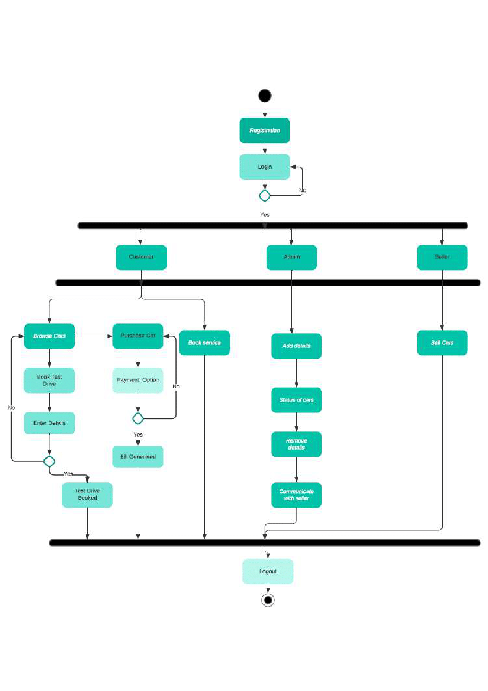
UML DIAGRAM - ACTIVITY DIAGRAM

Slide 10
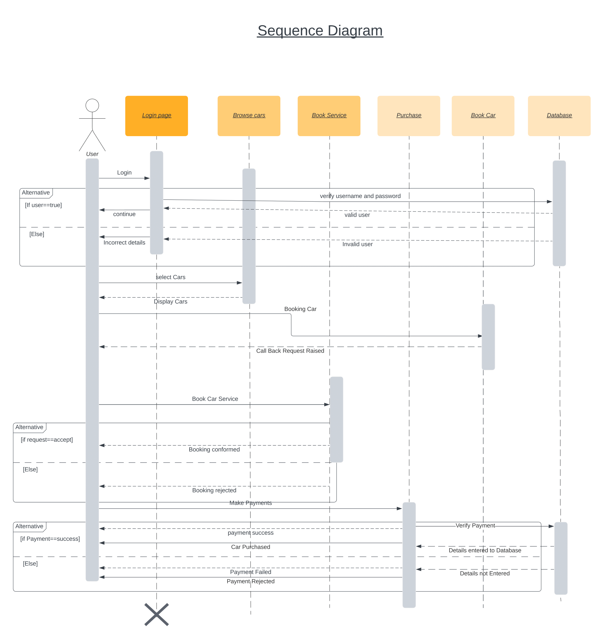
UML DIAGRAM – SEQUENCE DIAGRAM

Slide 11
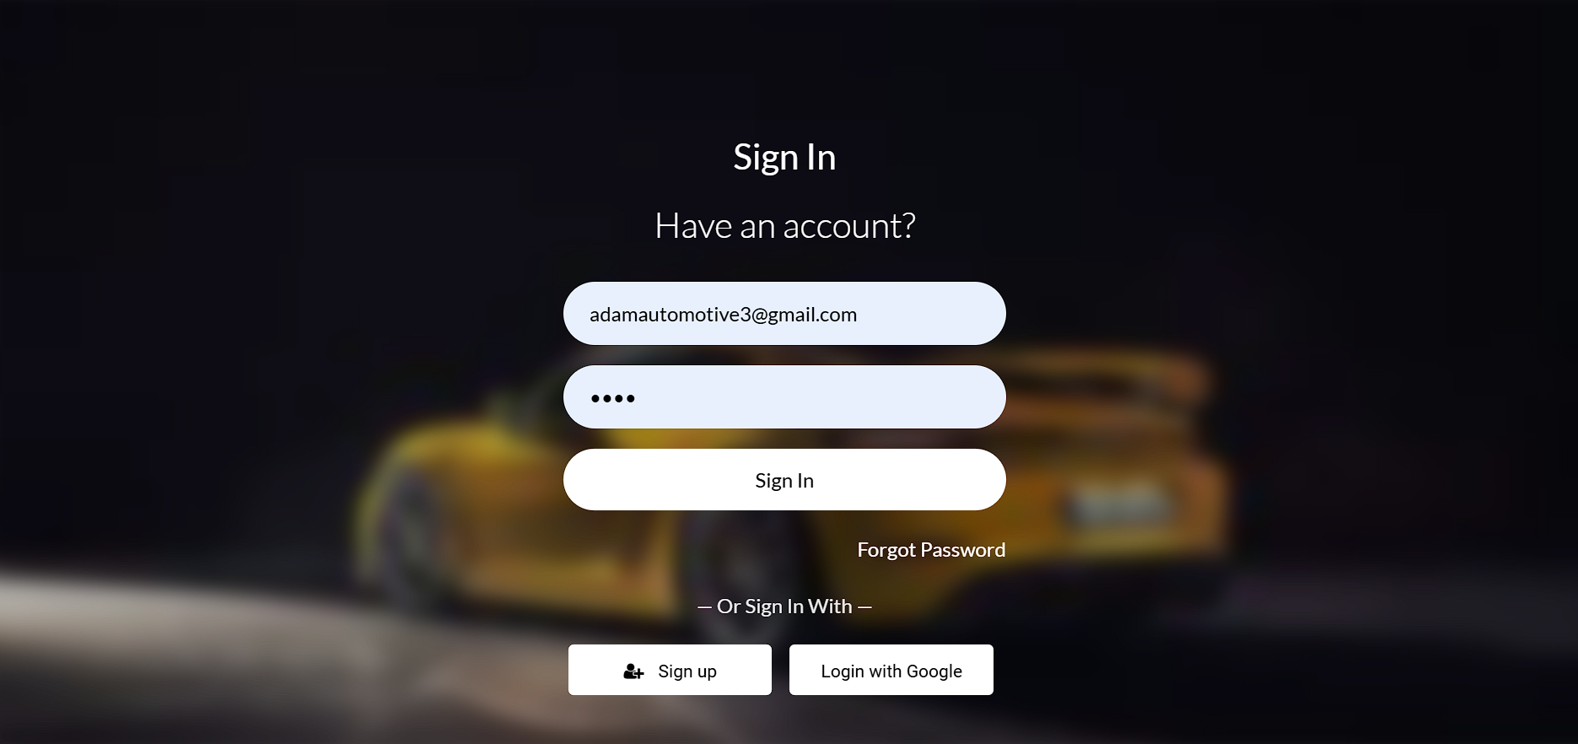
LOGIN PAGE

Slide 12
REGISTERATION PAGE

Slide 13
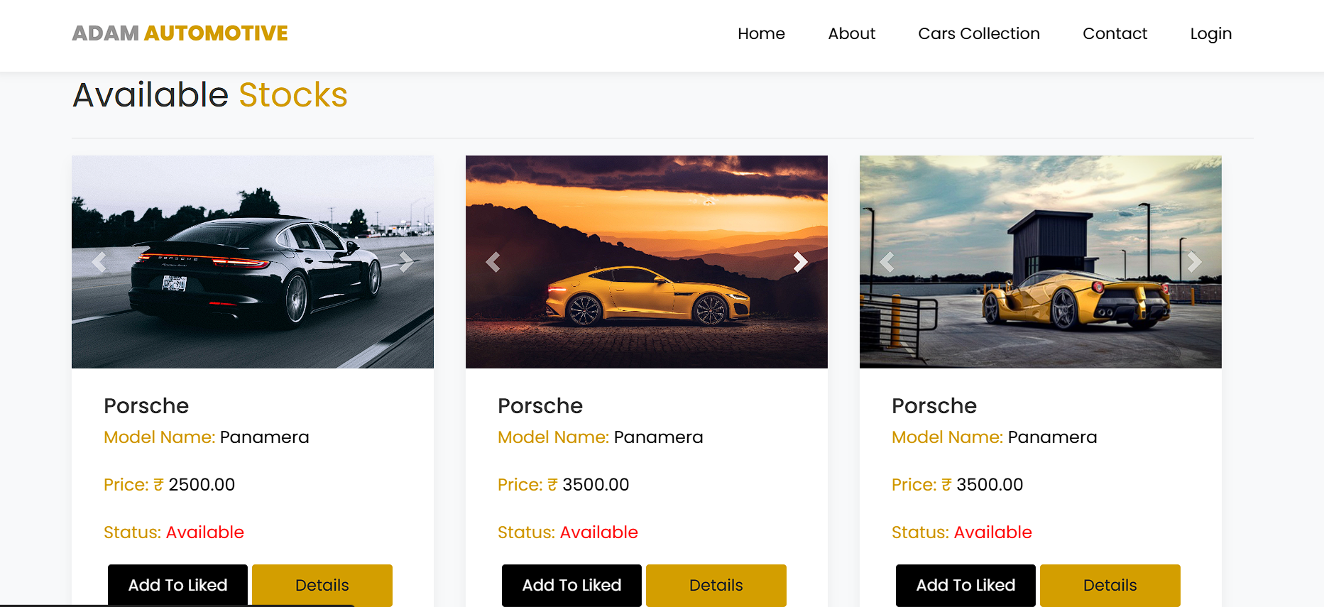
CAR COLLECTION

Slide 14
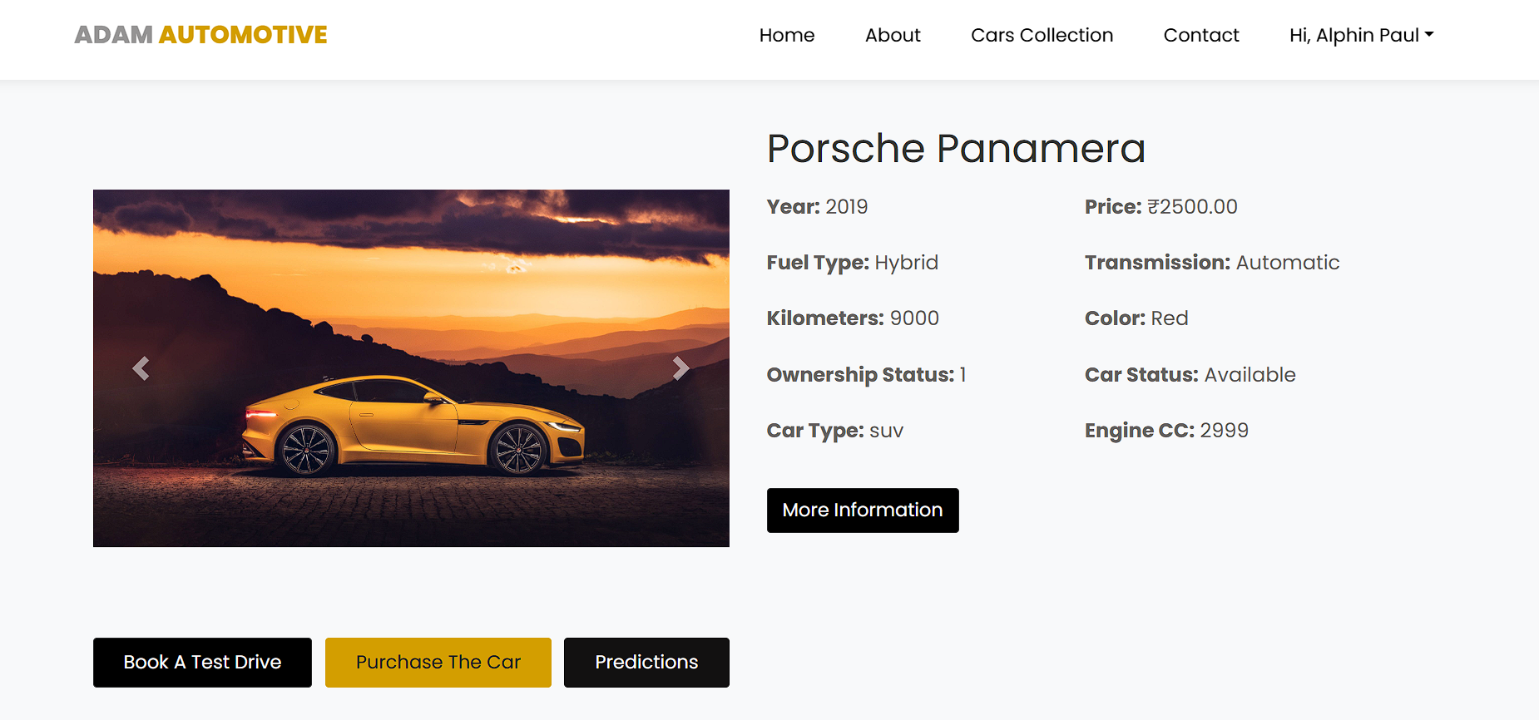
SPECIFIC CAR DETAILS

Slide 15
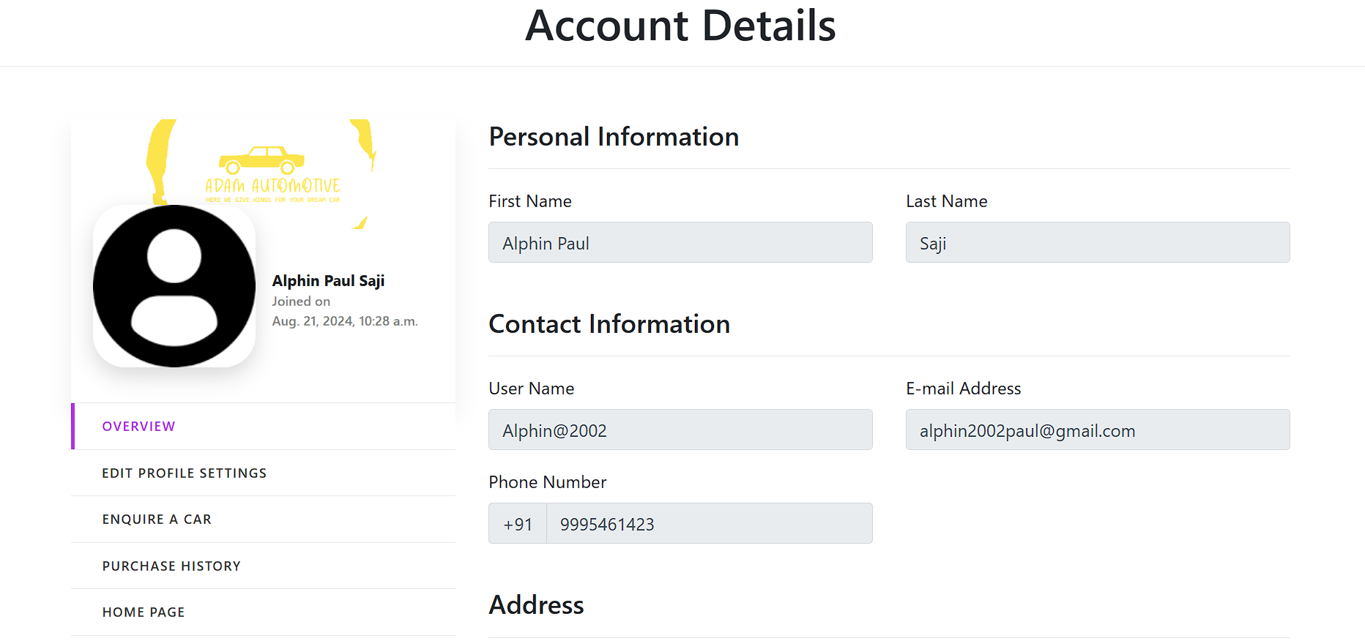
USER PROFILE

Slide 16
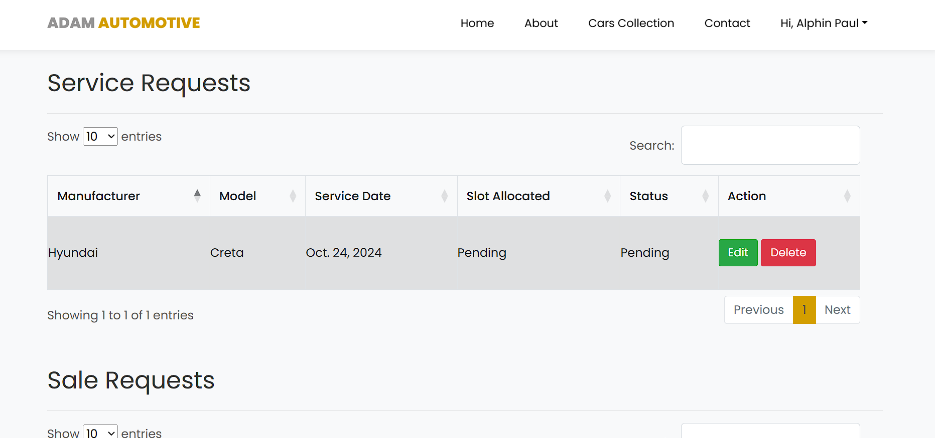
REQUEST VIEW PAGE

Slide 17
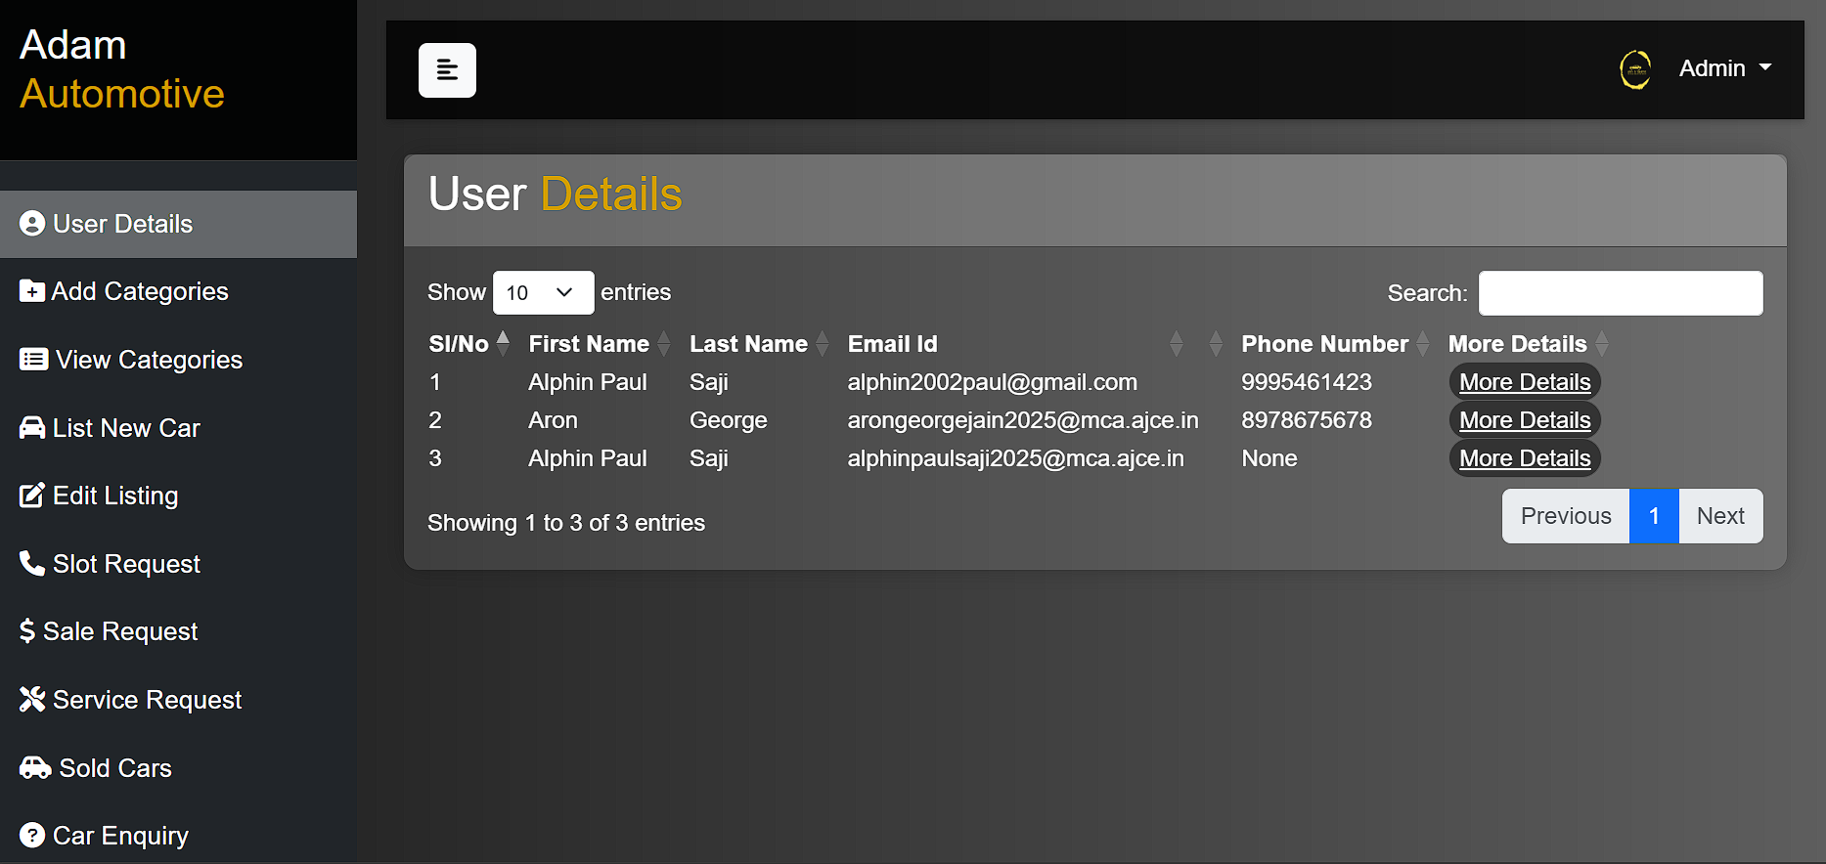
ADMIN PANEL

Slide 18
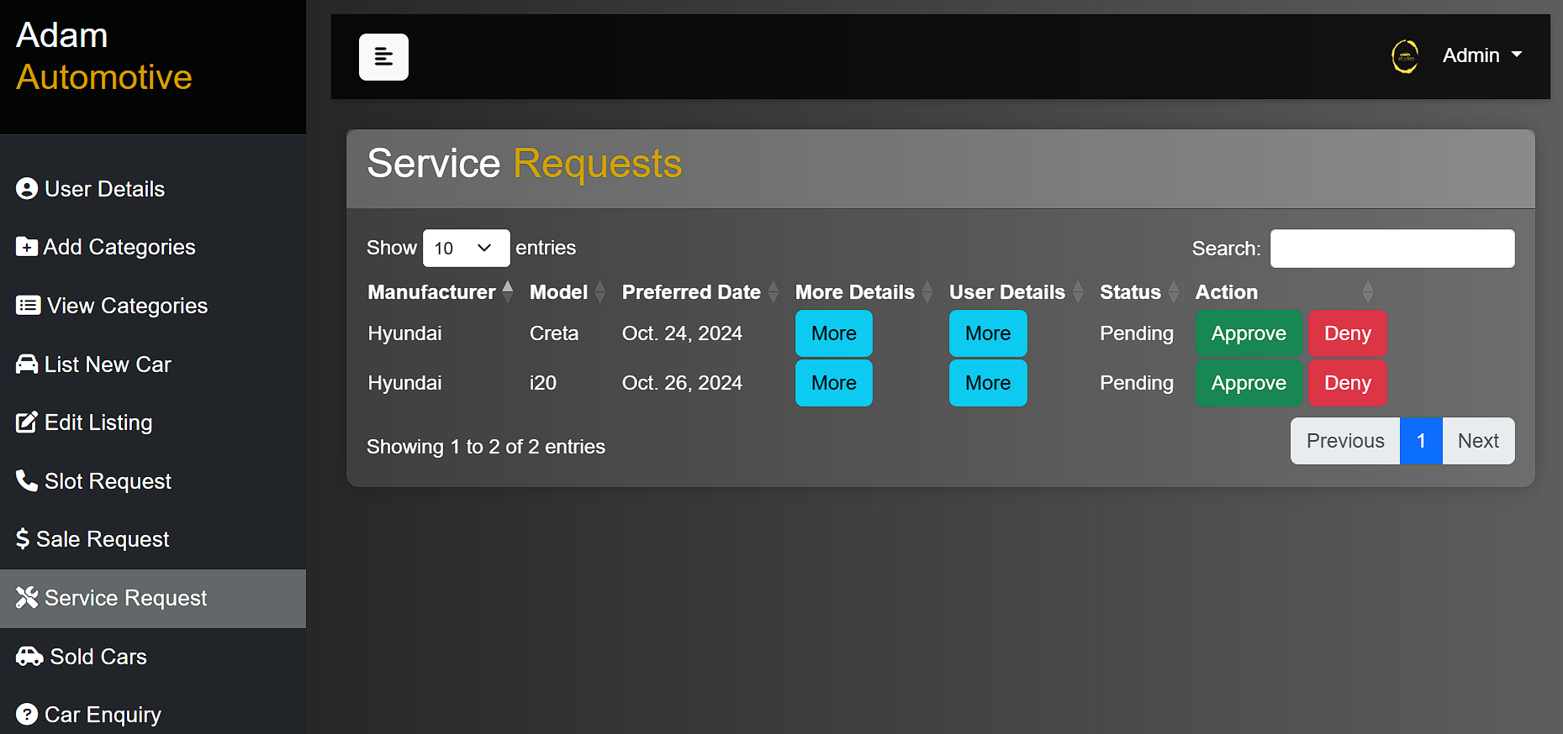
ADMIN PAGE FOR APPROVALS

Slide 19
Thank You…..

